Slide 1
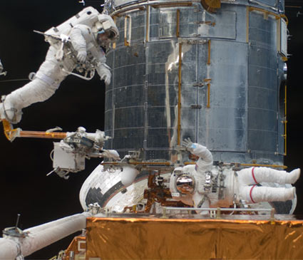

Slide 2
The High School
Pregame

Slide 3
It’s not spelled duel.

Slide 4
What is a pregame?
“Clear the mechanism.”
Billy Chapel
For the Love of the Game

Slide 5
What is a pregame?
A pregame is the discussion between the referees.
About the priorities and expectations of
the referee team.

Slide 6
Priorities
Newer referees:
Focus on team mechanics

Slide 7
Team mechanics
-Eye contact at every stoppage
-Ready for restart signal
Substitutions
Clock/Whistle
Resolving issues privately

Slide 8
Priorities
For experienced referees:
Team mechanics is not enough

Slide 9
Lead Referee and Trail Referee
Lead
Trail

Slide 10
Priorities and Expectations
When behind the ball (Trail), act like a center referee
When in front of the ball (Lead), act like an assistant referee

Slide 11
Priorities and Expectations
As the Trail referee, what do you expect/want the Lead referees to do?

Slide 12
Priorities and Expectations
As the Lead referee, what do you expect/want the Trail referees to do?

Slide 13
Priorities and Expectations
How do we handle transitions between Lead and Trail?

Slide 14
Always, Never or Sometimes
Talk about: Who is the head referee?
NEVER

Slide 15
Always, Never or Sometimes
Talk about: When should you call fouls that happen in front of your partner?
ALWAYS

Slide 16
Fouls Near The Partner
There is no “my half”
But, referees need to respect decisions (including no calls) by partners
Low fouls near partner (trip or slip?)
High fouls near partner (grab?)
What is my partner calling?

Slide 17
Always, Never or Sometimes
Talk about: that MLS match last night
NEVER

Slide 18
Always, Never or Sometimes
Talk about: the cute redhead in the stands
ALWAYS

Slide 19
Always, Never or Sometimes
Talk about: Intelligent Running
What’s that?

Slide 20
Intelligent Running
Adjust running based on partner’s location
If I see my partner’s back (meaning she’s jetting to get back on a quick counter),
I need to run down the middle of the field to cover fouls until she can turn.

Slide 21
Intelligent Running
Adjust running based on partner’s location
If my partner is trapped near the goal line and play transitions (meaning I’m jetting to get back on a quick counter),
I need to follow play like a referee until he can recover.

Slide 22
Every Pregame Should Cover:
T.E.A.M.

Slide 23
Every Pregame Should Cover:
Team mechanics
Experience
Anticipated style of play
Match situations

Slide 24
Team mechanics
-Eye contact at every stoppage
-Ready for restart signal
Substitutions
Resolving issues privately

Slide 25
Experience
With each other
With these teams
With these coaches

Slide 26
Anticipated Style of Play
Possession and control
Kick and run
Grudge match
Intelligent Running –change patterns to suit style of play

Slide 27
Intelligent Running
Possession and Control
Location of play: midfield
Fouls: grabs and ankle nips
Lower errors: missing fouls
Greater errors: offside (many targets)

Slide 28
Intelligent Running
Kick and Run
Location: 18 to 18
Fouls: Fouls when possession changes
Delaying fouls
Fouls in danger area
Lower errors: Offside (anticipated)
Greater errors: Missing fouls

Slide 29
Intelligent Running
Grudge match
Location: Everywhere
Fouls: Everywhere
Lower errors: None
Greater errors: Misconduct

Slide 30
Match Situations.
Corner kicks
Goal kicks
Free kicks near the 18
Penalty kicks
Mass confrontation

