Slide 1
2022-2023 nfhs soccer RULES CHANGES

Slide 2
OTHER EQUIPMENT
4-2-2
Hair control devices and other adornments worn in the hair must meet the following criteria:
Be securely fastened to the head.
Do not present an increased risk to the player, teammates or opponent.
This change promotes the inclusion of participants based on their cultural and religious beliefs.
Notes:
Hair control devices and other adornments worn in the hair must meet the following criteria:
Be securely fastened to the head.
Do not present an increased risk to the player, teammates or opponent.
This change promotes the inclusion of participants based on their cultural and religious beliefs.
Rationale: Creates inclusivity of hair styles while maintaining that the risk of injury to the athlete, teammates and opponents should not be compromised.

Slide 3
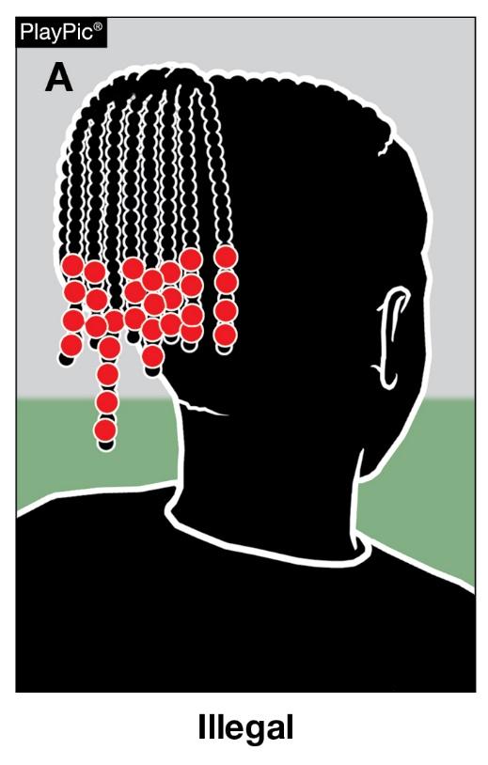
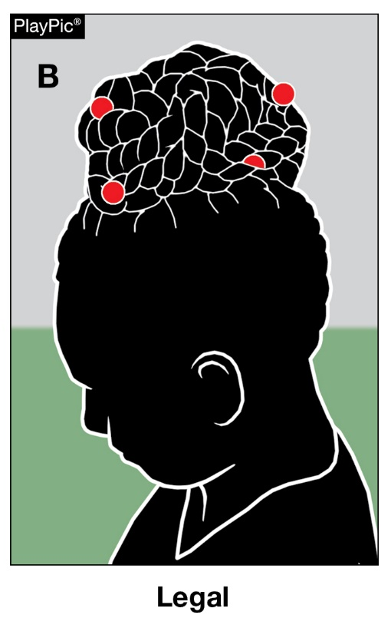
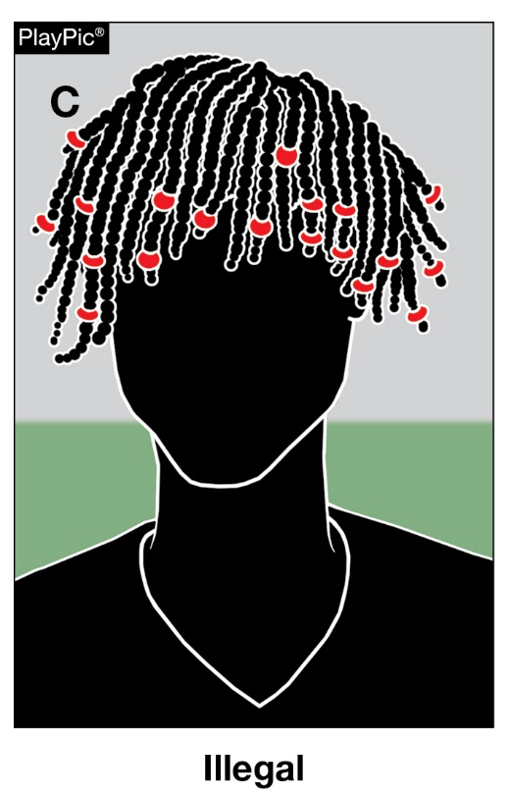
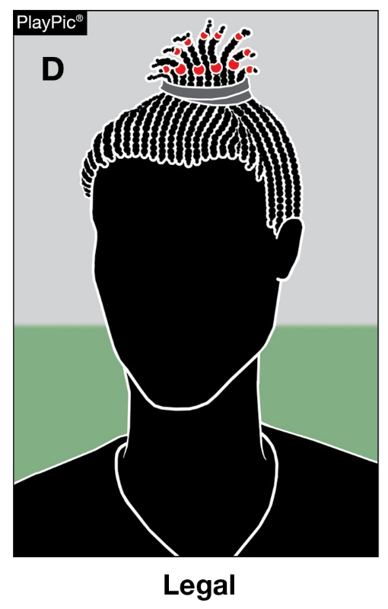
OTHER EQUIPMENT
4-2-2
In PlayPics A and C, the beads worn by each player are not securely fastened to the head. In PlayPic B and D, the beads worn are securely fastened to the head.
Notes:
Hair adornments that are securely fastened and do not increase risk to the player, teammates or opponents are permitted.
Rationale: Creates inclusivity of hair styles while maintaining that the risk of injury to the athlete, teammates and opponents should not be compromised.

Slide 4
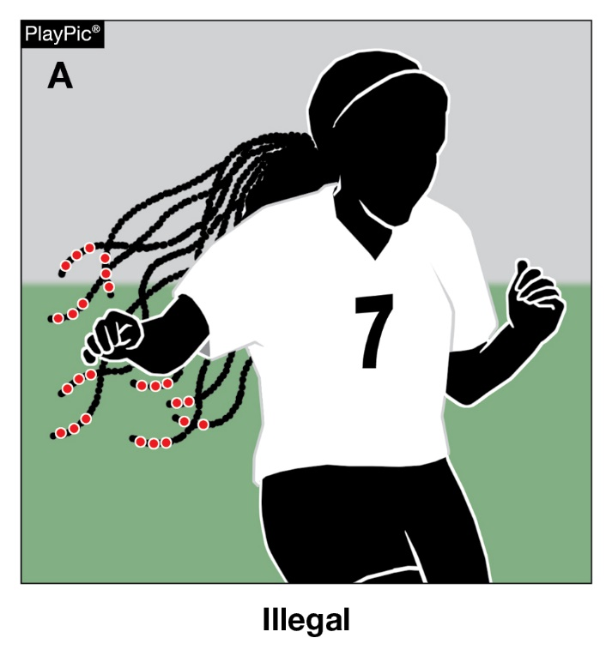
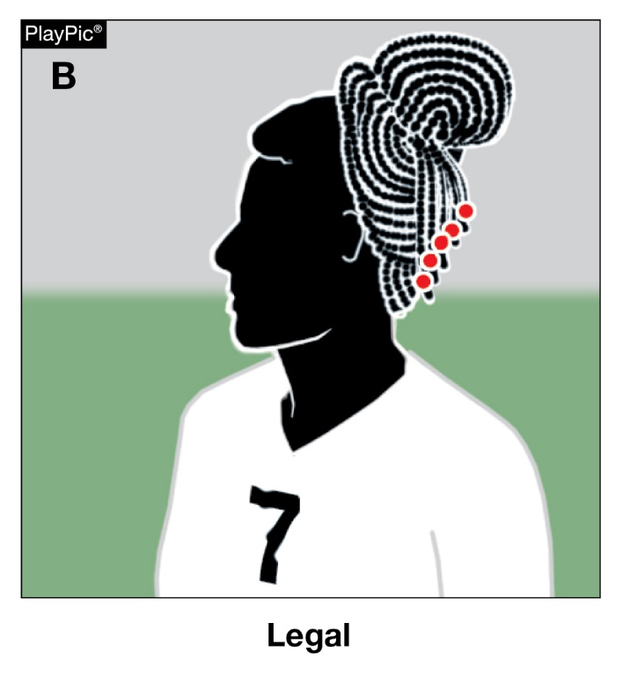
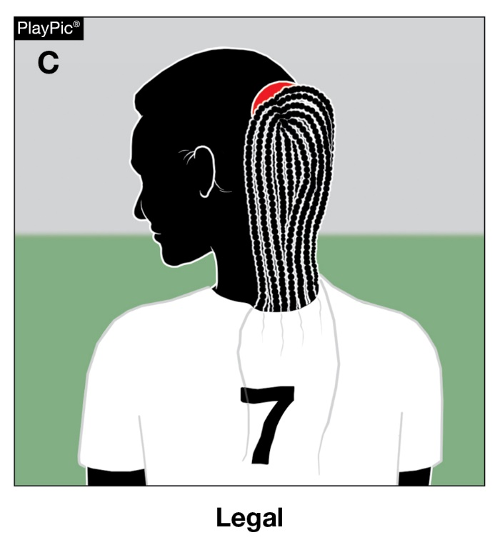
OTHER EQUIPMENT
4-2-2
In PlayPics A, the player cannot participate with the hair adornments worn in the current position since the adornments are not securely fastened to the head. Play Pics B and C are options to make legal.
Notes:
Hair put into a bun brings hair into compliance.
Hair tucked into the jersey or covered brings hair into compliance.
Rationale: Creates inclusivity of hair styles while maintaining that the risk of injury to the athlete, teammates and opponents should not be compromised.

Slide 5
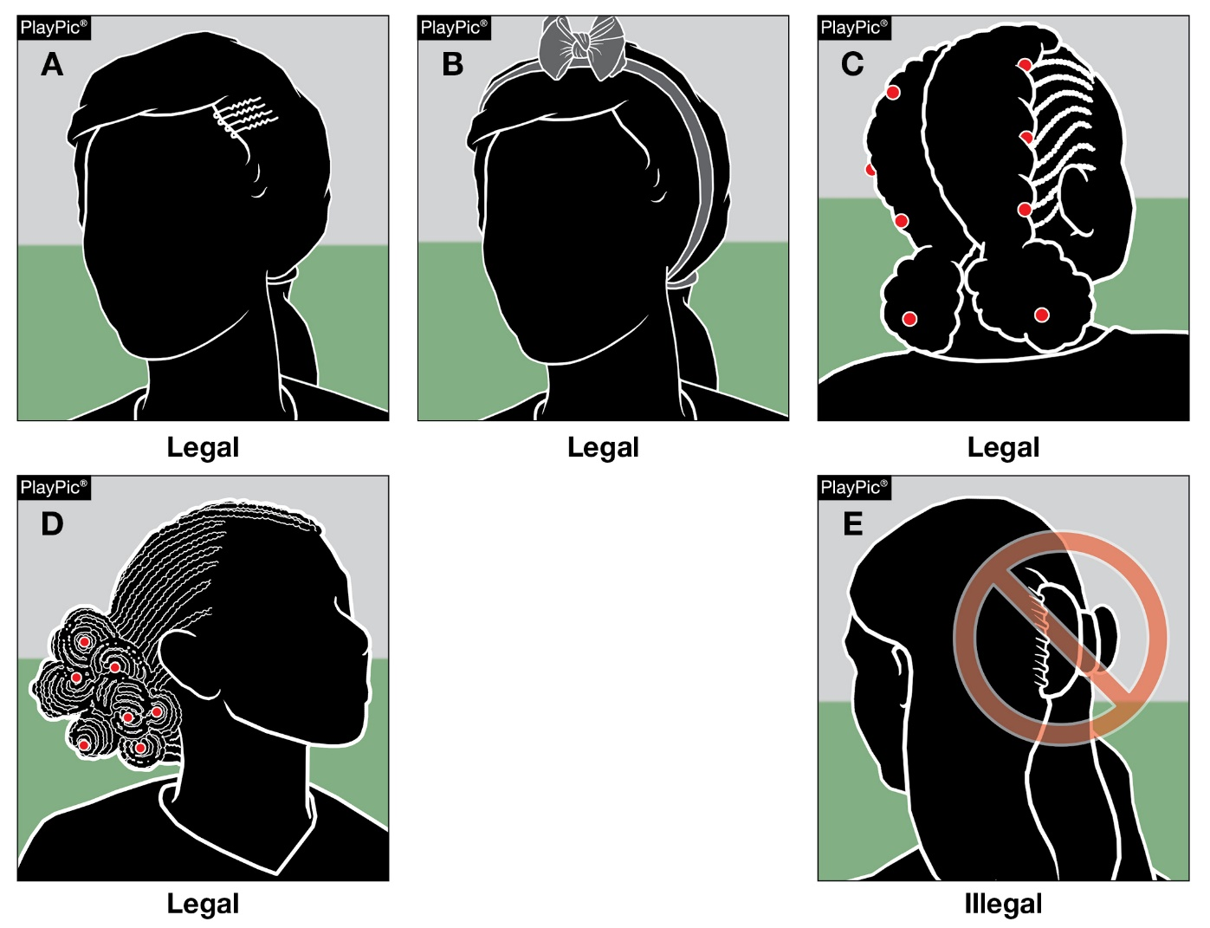
OTHER EQUIPMENT
4-2-2
In PlayPics A, B, C and D, the hair control devices worn are securely fastened and are legal.
In PlayPic E, the hair control device is illegal as it is not securely fastened to the head.
Notes:
Hair control devices that are securely fastened and do not increase risk to the athlete, teammates and opponents are permitted.
Hair clips that are hard, protrude from the head and/or are easily dislodged do not comply and are not legal.
Rationale: Creates inclusivity of hair styles while maintaining that the risk of injury to the athlete, teammates and opponents should not be compromised.

Slide 6
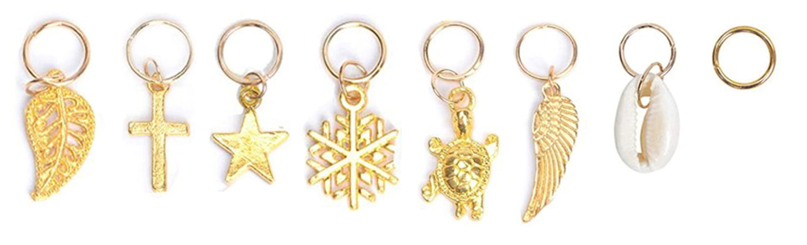
Equipment and accessories
4-1-6a
Hair charms are considered jewelry and per rule 4-1-7 would not be permitted.
Notes:
Hair charms are considered jewelry and per rule 4-2-4 would not be permitted.
Rationale: Maintains consistency that charms worn in the hair are considered jewelry and are not allowed.

Slide 7
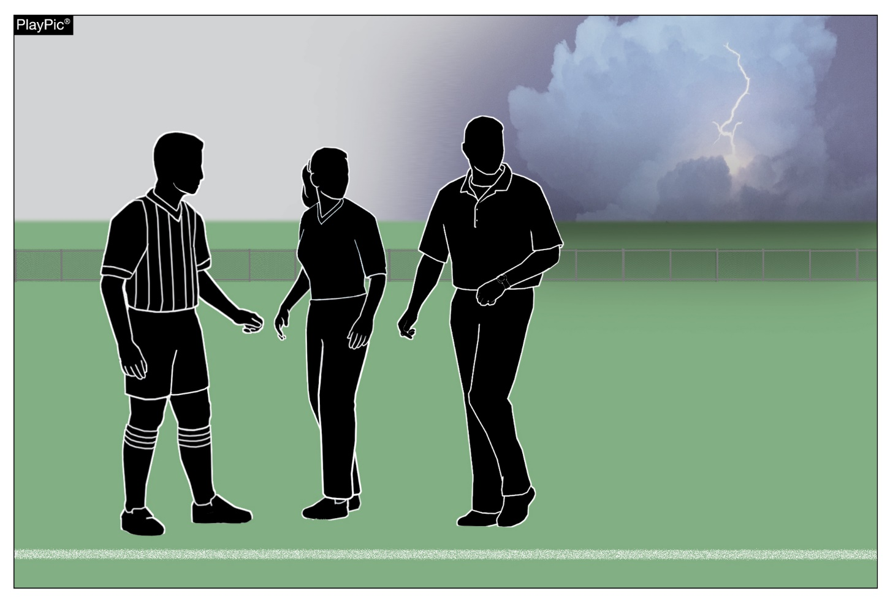
Suspended game
7-1-3
State associations may adopt game-ending procedures for suspended game.
Unless set forth by state association adoption, unless tied, it is an official game if one complete half or more of the game has been played.
State association procedures also govern games in which one complete half has not been completed
Notes:
State associations may adopt game-ending procedures for suspended game.
Unless set forth by state association adoption, unless tied, it is an official game if one complete half or more of the game has been played.
State association procedures also govern games in which one complete half has not been completed
Rationale: This allows states that may require the game to be played in its entirety (for post-season or regular season seeding play), to do so without a conflict with the current rule.

Slide 8
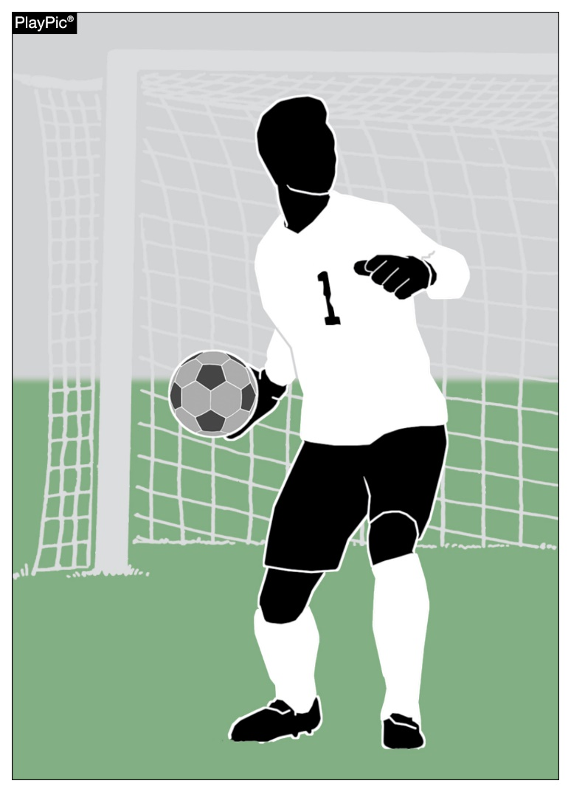
GOALS
10-1-2f, 10-1-3h new
A goal may not be scored directly from a goalkeeper’s throw into the opponent’s goal.
A goal may be scored for the opponents when a goalkeeper throws the ball into the team’s own goal.
Notes:
A goal may not be scored directly from a goalkeeper’s throw into the opponent’s goal.
A goal may be scored for the opponents when a goalkeeper throws the ball into the team’s own goal.
Rationale: Defined the outcomes on a goalkeeper’s throw when throwing the ball directly or own goal.

Slide 9
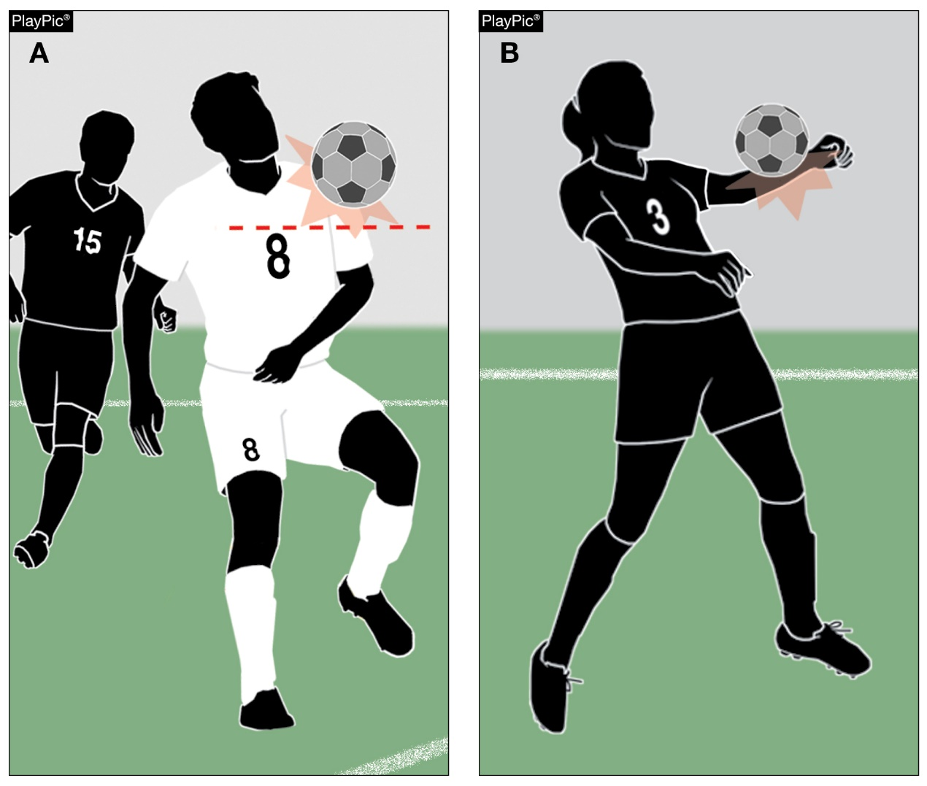
Handling
12-2
For the purposes of determining handling offences, the upper boundary of the arm is in line with the bottom of the armpit.
Notes:
For the purposes of determining handling offences, the upper boundary of the arm is in line with the bottom of the armpit.
Rationale: Defines the arm for the purposes of determining handling and offside.

Slide 10
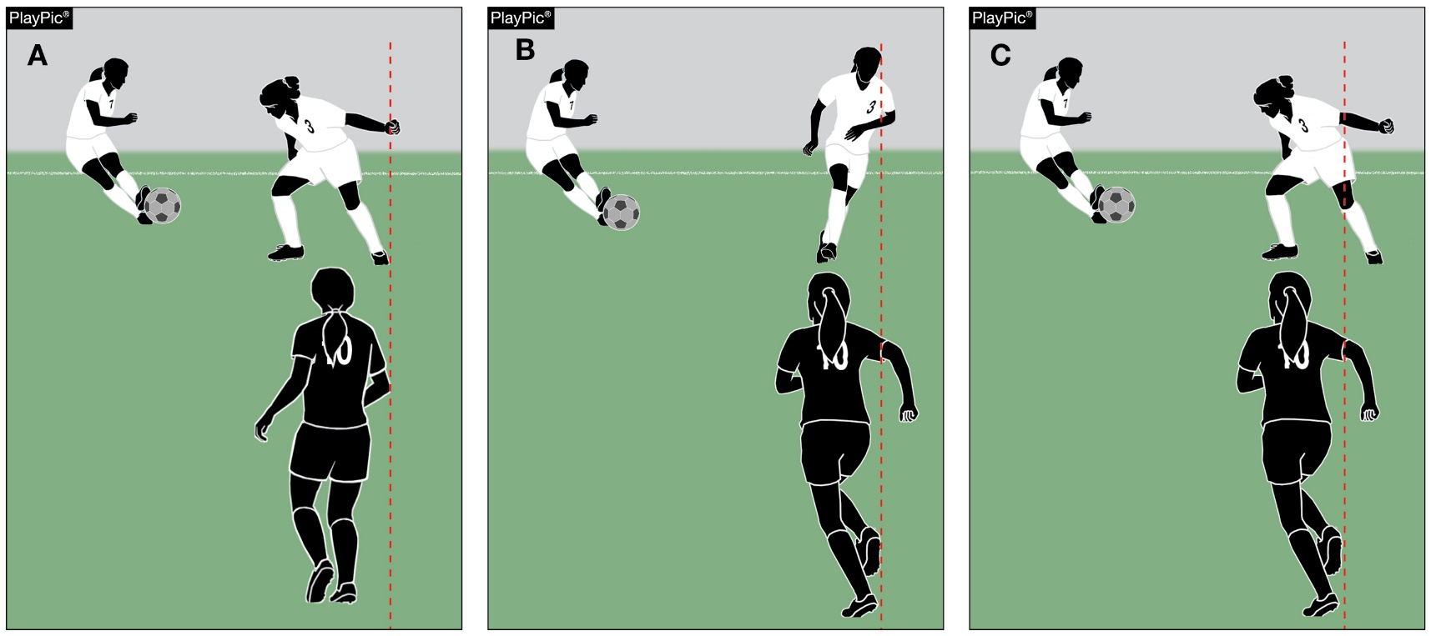
Offside definitions of playing terms
11-1-1, 18-1-1s
In PlayPic A, offside is judged by the upper boundary of #10’s arm — in line with the bottom of the armpit compared to #3 of the attacking team. #3 of the attacking team is not offside.
In PlayPic B, even though #10’s right arm is beyond #3’s left shoulder, #3 is offside. The position of the hand/lower arm is not considered when determining offside.
In PlayPic C, even though part of #10’s hand/lower arm is beyond #3’s left leg, #3 is offside.
For the purposes of determining offside, the upper boundary of the arm is in line with the bottom of the armpit.
Notes:
In PlayPic A, offside is judged by the upper boundary of #10’s arm — in line with the bottom of the armpit compared to #3 of the attacking team. #3 of the attacking team is not offside.
In PlayPic B, even though #10’s right arm is beyond #3’s left shoulder, #3 is offside. The position of the hand/lower arm is not considered when determining offside.
In PlayPic C, even though part of #10’s hand/lower arm is beyond #3’s left leg, #3 is offside.
Rationale: Defines the arm for the purposes of determining handling and offside.

Slide 11
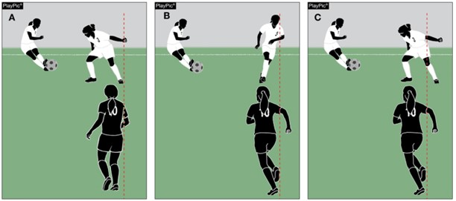
Offside definitions of playing terms
11-1-1, 18-1-1s
In PlayPic A, offside is judged by the upper boundary of #10’s arm — in line with the bottom of the armpit compared to #3 of the attacking team. #3 of the attacking team is not offside.
In PlayPic B, even though #10’s right arm is beyond #3’s left shoulder, #3 is offside. The position of the hand/lower arm is not considered when determining offside.
In PlayPic C, even though part of #10’s hand/lower arm is beyond #3’s left leg, #3 is offside.
For the purposes of determining offside, the upper boundary of the arm is in line with the bottom of the armpit.
Notes:
In PlayPic A, offside is judged by the upper boundary of #10’s arm — in line with the bottom of the armpit compared to #3 of the attacking team. #3 of the attacking team is not offside.
In PlayPic B, even though #10’s right arm is beyond #3’s left shoulder, #3 is offside. The position of the hand/lower arm is not considered when determining offside.
In PlayPic C, even though part of #10’s hand/lower arm is beyond #3’s left leg, #3 is offside.
Rationale: Defines the arm for the purposes of determining handling and offside.

Slide 12
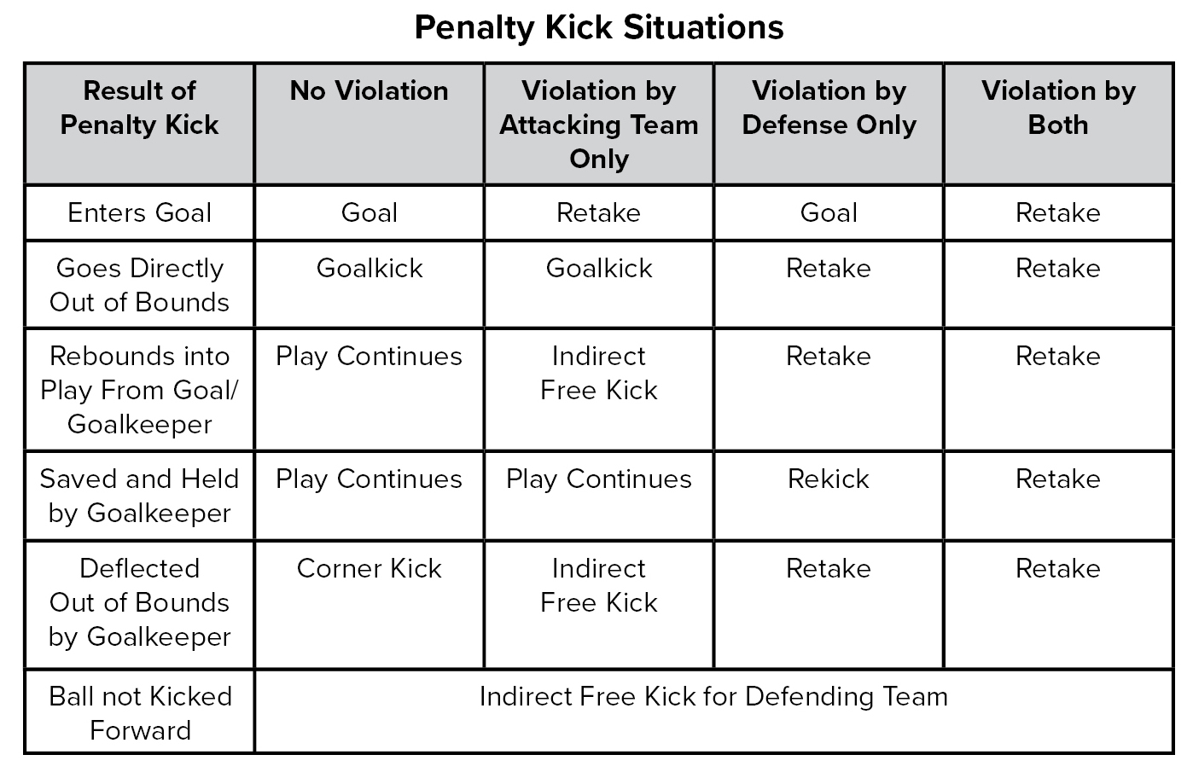
Penalty kick
14-1 penalty
When the ball is not kicked forward on a penalty kick, the defending team is now awarded an indirect free kick. The penalty kick is no longer retaken in this instance.
Additionally, language changes were made to the Penalty Kick Situations Chart to more accurately describe a kick taken again as a Retake.
Notes:
When the ball is not kicked forward on a penalty kick, the defending team is now awarded an indirect free kick. The penalty kick is no longer retaken in this instance.
Additionally, language changes were made to the Penalty Kick Situations Chart to more accurately describe a kick taken again as a Retake.
Rationale: Penalizes the kicking team for not kicking the ball forward on penalty kick.

Slide 13
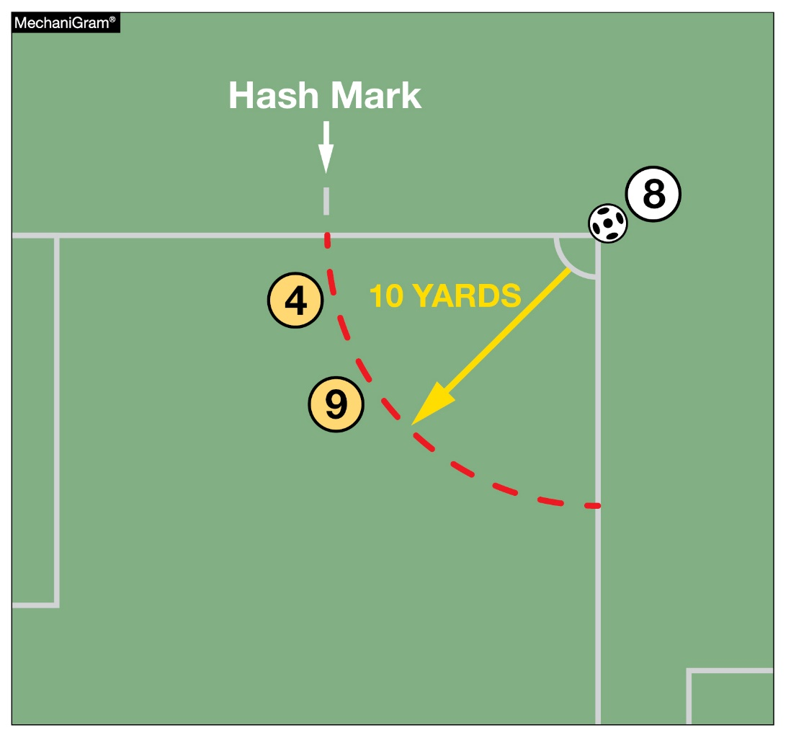
Corner kick
17-1-2, 17-1-3
Players of the defending team shall be at least 10 yards from the corner arc circle until the ball has been kicked.
The distance is now measured from the corner arc instead of the ball.
Notes:
Players of the defending team shall be at least 10 yards from the corner arc circle until the ball has been kicked.
The distance is now measured from the corner arc instead of the ball.
Rationale: Clarifies the proper distance for the opposing team on a corner kick.

Slide 14
2022-2023 NFHS soccer editorial changes

Slide 15
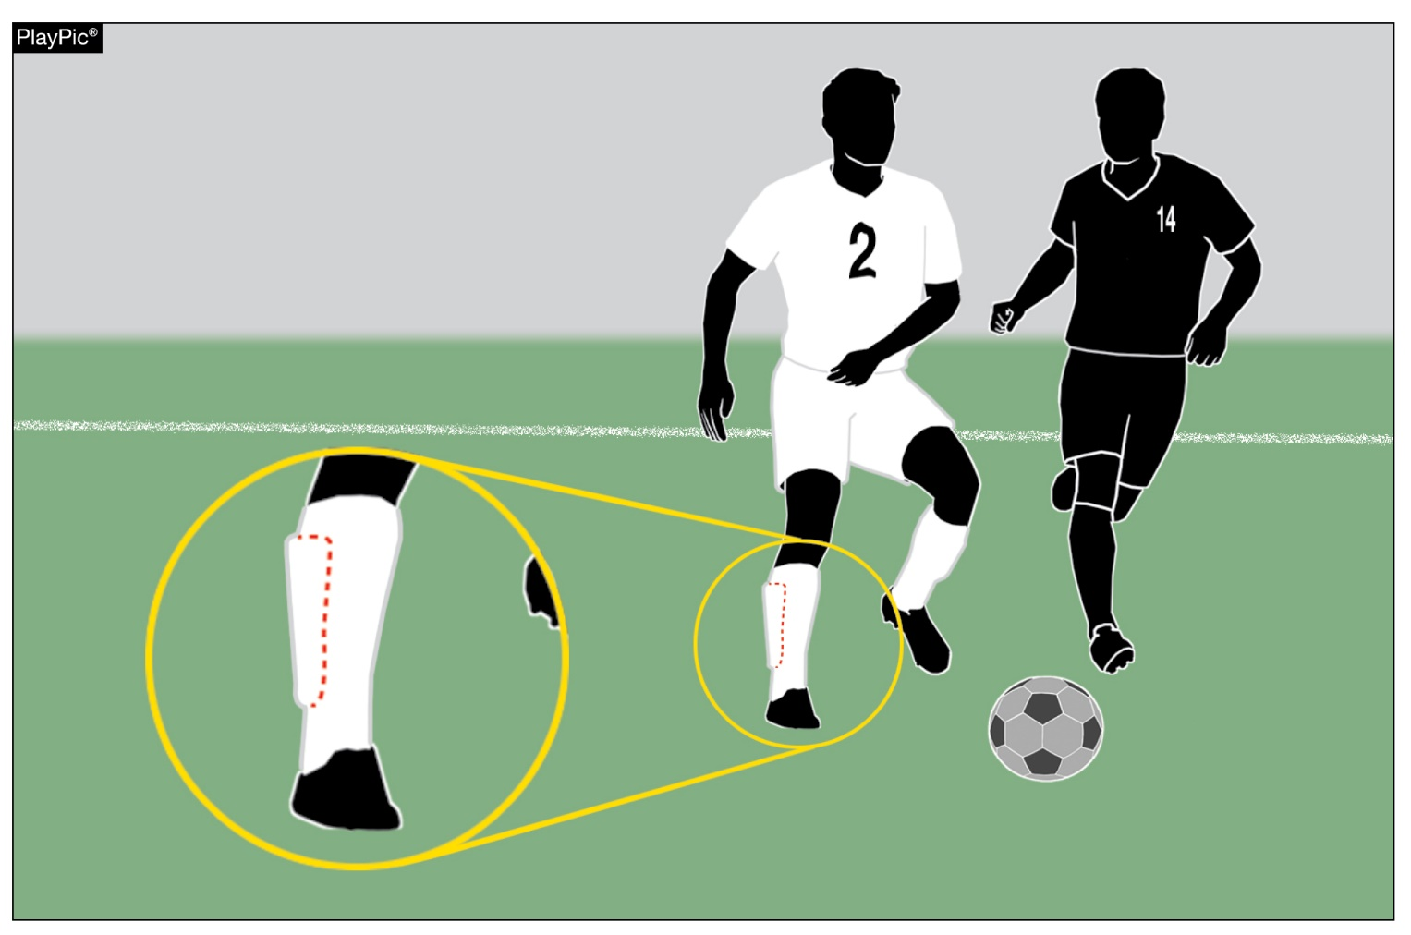
Required equipment
4-1-1
4-1-1 was reorganized to assist with easier flow and understanding.
Shinguards must:
Provide adequate and reasonable protection.
Be professionally manufactured.
Be age and size-appropriate.
Not be altered to decrease protection.
Be worn under the socks and worn with the bottom edge no higher than 2 inches about the ankle.
Meet the NOCSAE standards at the time of manufacture.
Additionally, shinguards must be worn properly.
Notes:
4-1-1 was reorganized to assist with easier flow and understanding.
Shinguards must:
Provide adequate and reasonable protection.
Be professionally manufactured.
Be age and size-appropriate.
Not be altered to decrease protection.
Be worn under the socks and worn with the bottom edge no higher than 2 inches about the ankle.
Meet the NOCSAE standards at the time of manufacture.
Additionally, shinguards must be worn properly.
Rationale: A reorganization of the uniform rule to assist with easier flow and understanding

Slide 16
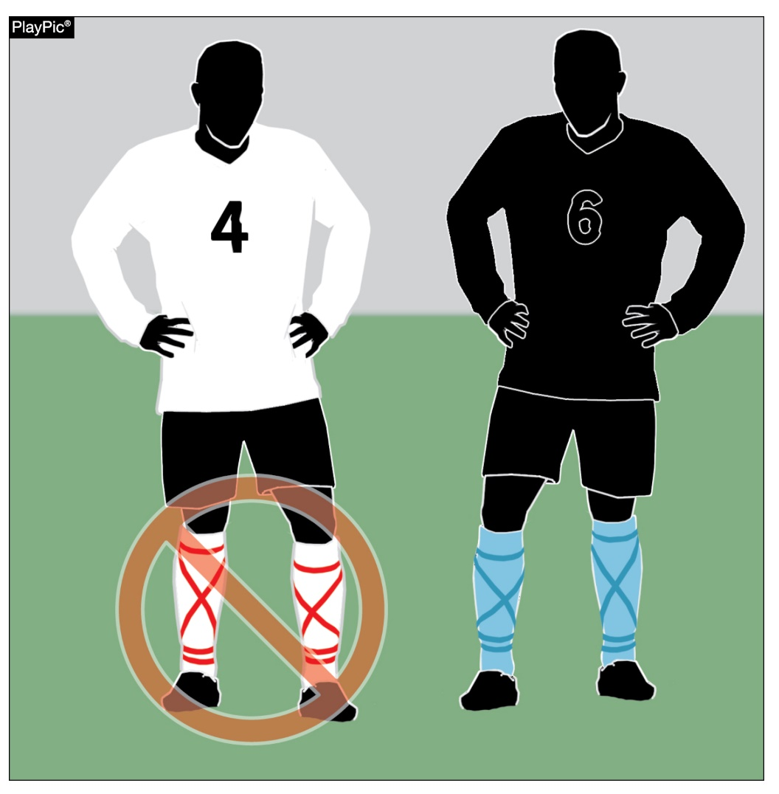
Required equipment
4-1-1 (SOCKS)
Teammates shall wear the same-colored socks.
Visiting team players wear solid white socks
Home team players wear socks of a single dominant color, but not necessarily the color of the jersey.
If tape or a similar material (stays/straps) is applied externally to the socks, it must be of similar color as that part of the sock to which it is applied.
If sock is modified by cutting off the foot of the sock, then any visible material worn under the sock and above the ankle must be of similar color to the predominant color of the sock.
Notes:
ART. 1 . . . The required player equipment includes a jersey, shorts, socks, suitable shoes and shinguards. With the exception of socks, equipment shall not be modified from its original manufactured state and shall be worn in the manner the manufacturer intended it to be worn.
Teammates shall wear the same-colored socks.
Visiting team players wear solid white socks
Home team players wear socks of a single dominant color, but not necessarily the color of the jersey.
If tape or a similar material (stays/straps) is applied externally to the socks, it must be of similar color as that part of the sock to which it is applied.
If sock bottoms are modified by cutting off the foot of the sock then any visible material worn under the sock and above the ankle must be of similar color to the predominant color of the sock.
Rationale: A reorganization of the uniform rule to assist with easier flow and understanding.

Slide 17
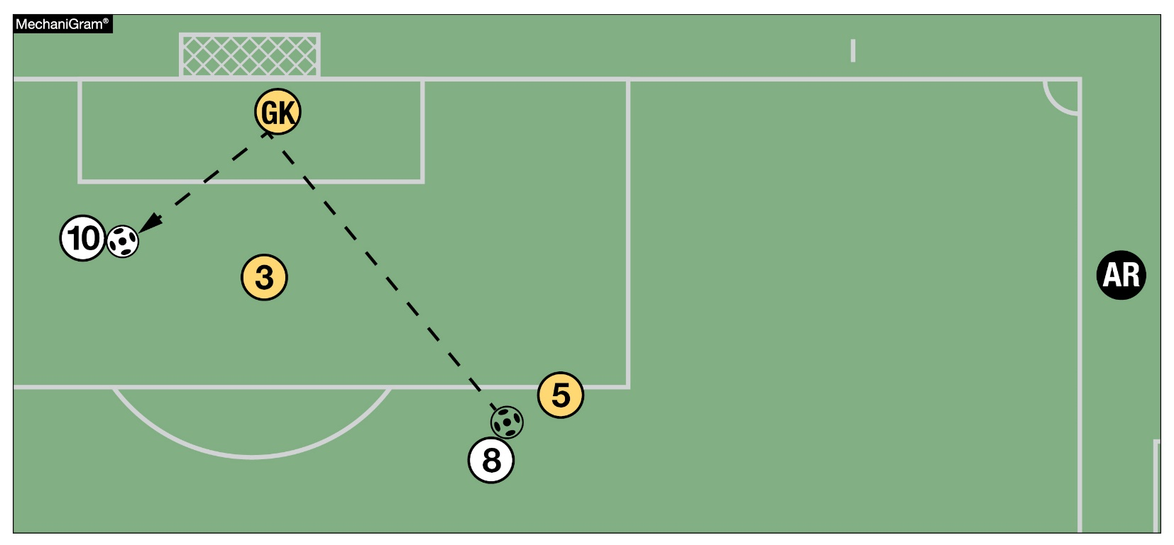
Offside
11-1-4b
11-1-4b was revised to clarify that offside shall be ruled if the player is gaining an advantage by being in an offside position.
In this MechaniGram, A10 is offside since the player is receiving the ball from a deliberate save by the goalkeeper.
Notes:
11-1-4b was revised to clarify that offside shall be ruled if the player is gaining an advantage by being in an offside position.
In this MechaniGram, A10 is offside since the player is receiving the ball from a deliberate save by the goalkeeper.
Rationale: Consistent language throughout the book and better understanding that the player is gaining an advantage.

Slide 18
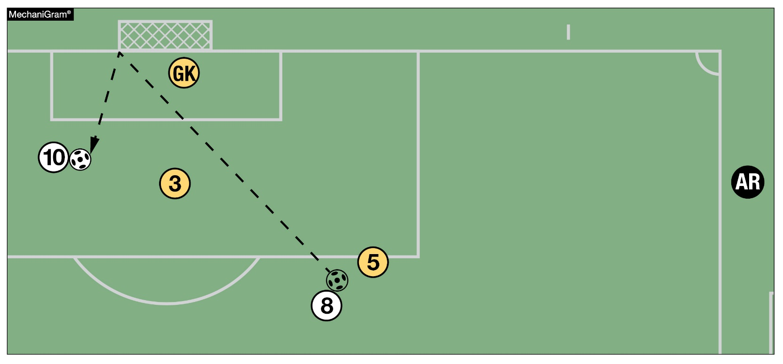
Offside
11-1-4b
11-1-4b was revised to clarify that offside shall be ruled if the player is gaining an advantage by being in an offside position.
In this MechaniGram, A10 is offside since the player is gaining an advantage by playing the ball after it hits the post.
Notes:
In this MechaniGram, A10 is offside since the player is gaining an advantage by playing the ball after it hits the post.

Slide 19
Points of emphasis

Slide 20
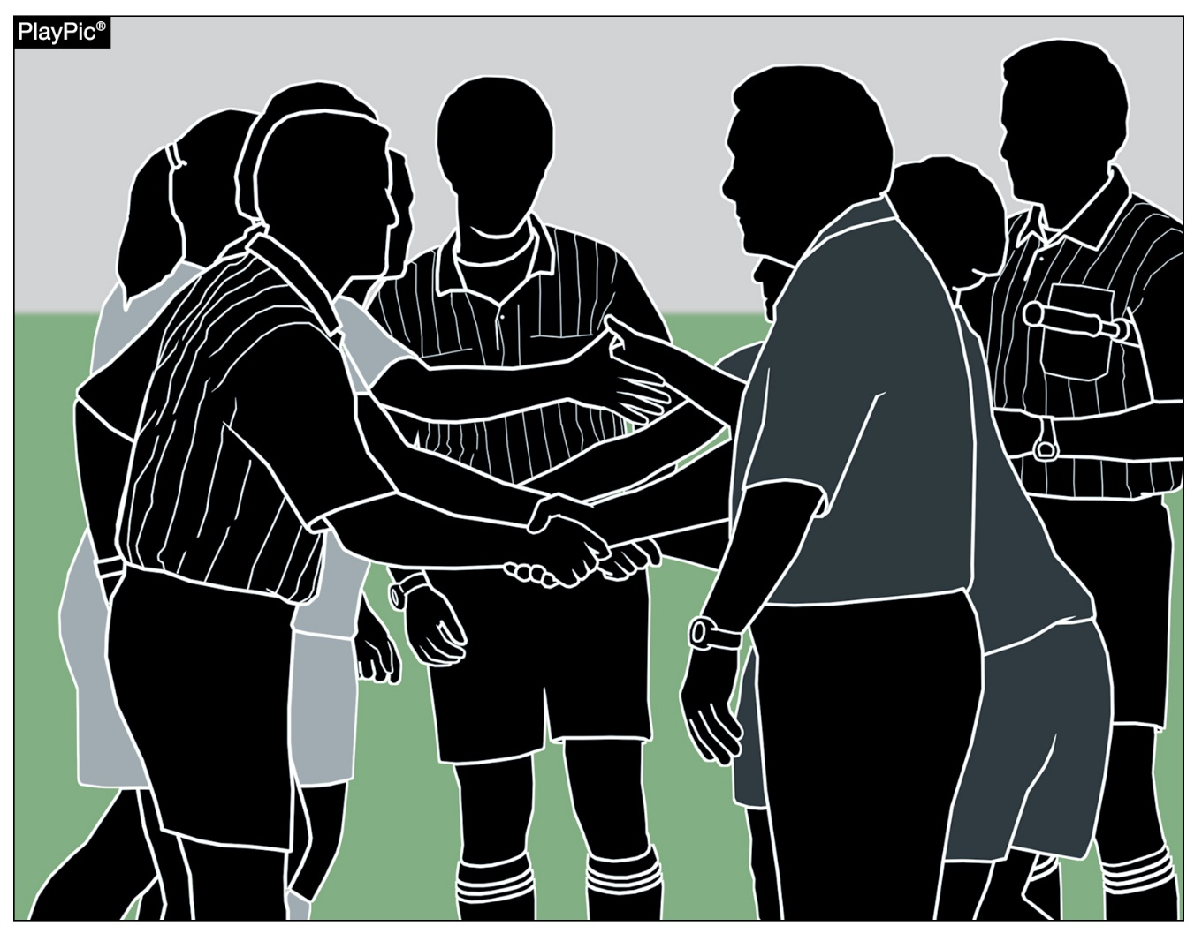
sportsmanship
The NFHS is concerned that unsporting behavior in education-based athletic has increased across all sports. As a result, the NFHS has made sportsmanship the no. 1 Point of Emphasis for the 2022-23 school year.
The interscholastic coach is responsible for setting the tone at athletic contests and must act in a sportsmanlike manner.
If coaches are complaining constantly about the decision of contest officials, spectators are likely to do the same.
Notes:
The NFHS is concerned that unsporting behavior in education-based athletic has increased across all sports. As a result, the NFHS has made sportsmanship the no. 1 Point of Emphasis for the 2022-23 school year.
The interscholastic coach is responsible for setting the tone at athletic contests and must act in a sportsmanlike manner.
If coaches are complaining constantly about the decision of contest officials, spectators are likely to do the same.

Slide 21
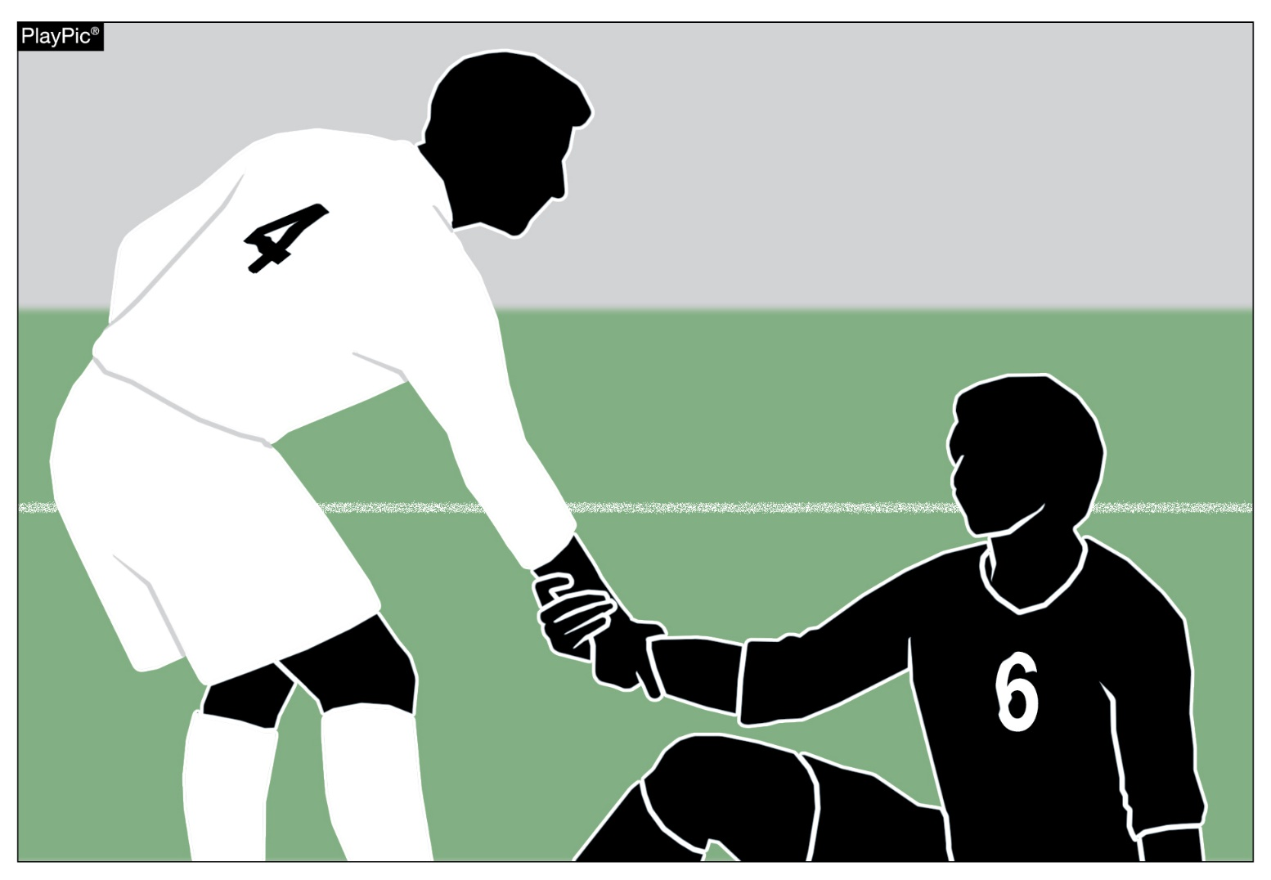
sportsmanship
A positive, open line of communication between officials and coaches ultimately leads to better behavior by student-athletes.
Good sporting behavior is expected before, during and after every contest.
Notes:
A positive, open line of communication between officials and coaches ultimately leads to better behavior by student-athletes.
Good sporting behavior is expected before, during and after every contest.

Slide 22
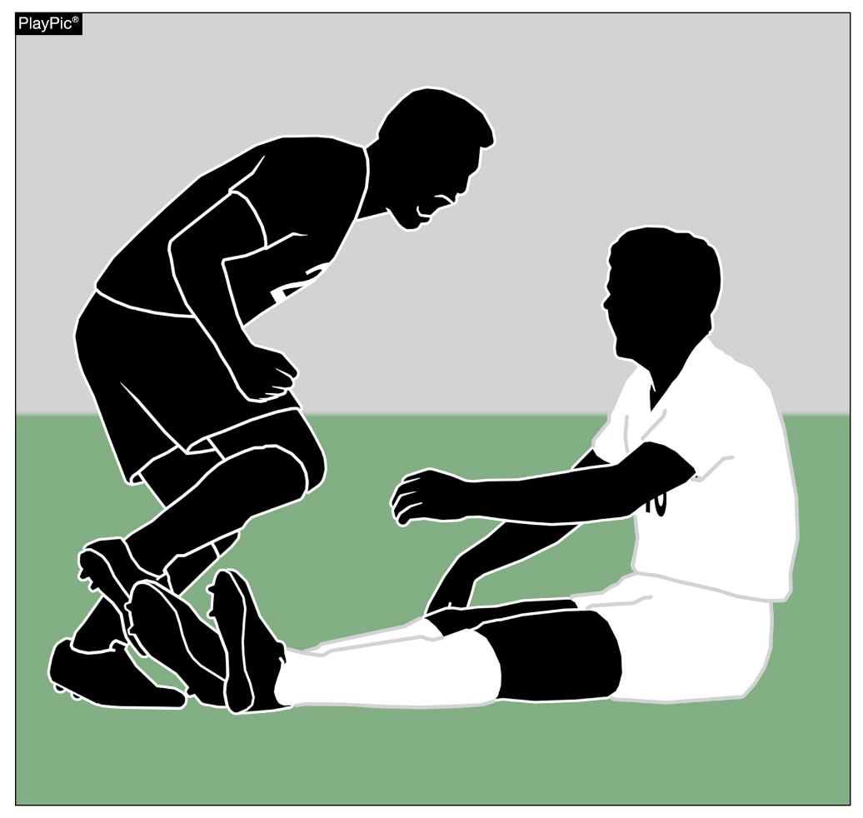
sportsmanship
Contest officials should never engage with spectators who are exhibiting unsporting behavior. Instead, school administration, or in their absence, the home team’s head coach is responsible for dealing with unruly spectators.
The NFHS is concerned about unsporting behavior inhibiting the recruitment and retainment of officials.
In addition, an environment with demeaning language, taunting and/or hate speech directed at players does not further the mission of education-based activity programs.
Notes:
Contest officials should never engage with spectators who are exhibiting unsporting behavior. Instead, school administration, or in their absence, the home team’s head coach is responsible for dealing with unruly spectators.
The NFHS is concerned about unsporting behavior inhibiting the recruitment and retainment of officials.
In addition, an environment with demeaning language, taunting and/or hate speech directed at players does not further the mission of education-based activity programs.

Slide 23
Strategic time-wasting techniques
Time-wasting techniques disrupt the flow of the game and allow a team to gain an unfair advantage.
Officials must be aware of these tactics including:
Goalkeepers holding the ball for longer than 6 seconds before releasing the ball into play.
Delays on restarts such as free kicks or throw-ins. For example, when players take unnecessary time to set up a free kick or throw-in by re-tying their shoe or adjusting their uniform.
Team excessively substituting before the 5-minute rule applies.
Notes:
Time-wasting techniques disrupt the flow of the game and allow a team to gain an unfair advantage.
Officials must be aware of these tactics including:
Goalkeepers holding the ball for longer than 6 seconds before releasing the ball into play.
Delays on restarts such as free kicks or throw-ins. For example, when players take unnecessary time to set up a free kick or throw-in by re-tying their shoe or adjusting their uniform.
Team excessively substituting before the 5-minute rule applies.

Slide 24
Penalty kick
A stutter step or a hesitation move is permissible.
The ball must be kicked forward.
If the ball is not kicked forward, an indirect free kick is awarded to the defending team from the penalty kick mark.
Notes:
A stutter step or a hesitation move is permissible.
The ball must be kicked forward.
If the ball is not kicked forward, an indirect free kick is awarded to the defending team from the penalty kick mark.

Slide 25
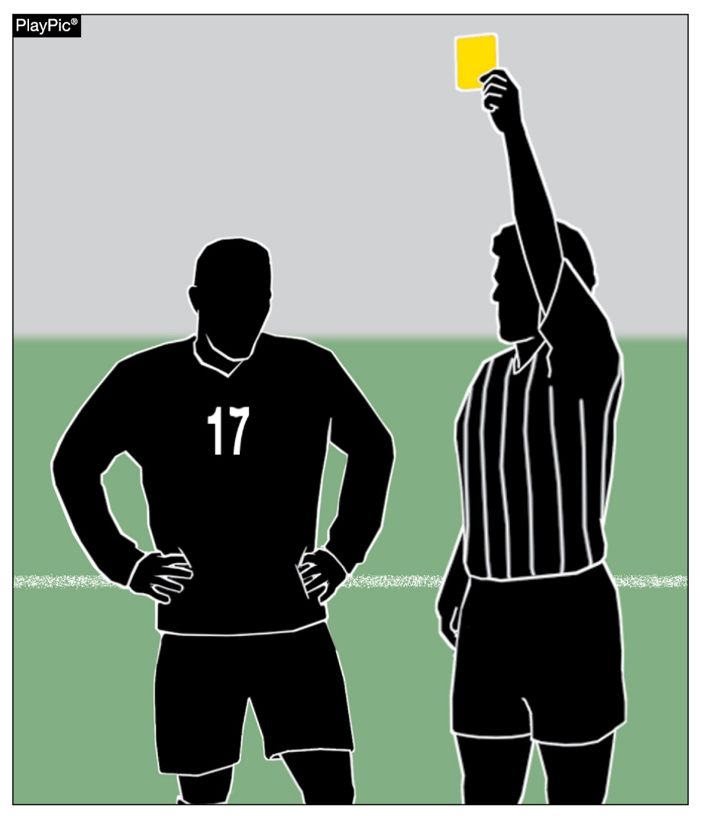
dissent
Rule 12-8-1c defines dissent.
Expressions of frustration or disappointment or private dissatisfaction not directed at anyone can usually be handled by a verbal warning or private discussion with the player.
Simply disagreeing with an official’s decision isn’t always dissent. Several factors to consider in each situation.
Continual public complaining, prolonged and repeated actions or personally directing comments at the referees must be dealt with.
Notes:
Rule 12-8-1c defines dissent.
Expressions of frustration or disappointment or private dissatisfaction not directed at anyone can usually be handled by a verbal warning or private discussion with the player.
Simply disagreeing with an official’s decision isn’t always dissent. Several factors to consider in each situation.
Continual public complaining, prolonged and repeated actions or personally directing comments at the referees must be dealt with.

Slide 26
NFHS Learning Center

Slide 27

Notes:
The NFHS Learning Center is the home to more than 90 online professional development courses for everyone within the interscholastic community - coaches, students, officials, parents, administrators, and individuals within performing arts programs. More than 60 courses are available for free.
The NFHS is an Accredited Institution and has delivered more than 15 million courses on its NFHS Learning Center platform since its inception in 2007. In receiving national accreditation by Cognia, the NFHS has upheld itself to rigorous standards that focus on productive learning environments, equitable resource allocation that meet the needs of learners, and effective leadership.
The NFHS Learning Center features its flagship coaching course, “Fundamentals of Coaching,” as well as several health and safety courses that have been completed by millions of individuals, such as “Concussion in Sports,” “Heat Illness Prevention,” “Sudden Cardiac Arrest” and “Protecting Students from Abuse.” The NFHS Learning Center offers several national credentials that can be earned by individuals who complete specific NFHS courses. Through the School Honor Roll Program, schools can earn a physical banner to hang in their school.
To learn more and start your professional development journey, please visit the NFHS Learning Center at NFHSLearn.com.

